Slide 1
Air-Conditioning - Symbols

Slide 2
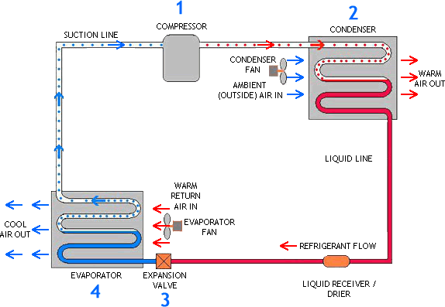
Main Components
Blower Motor
Compressor
Condenser
Expansion Valve
Filter Dryer
Evaporator

Slide 3
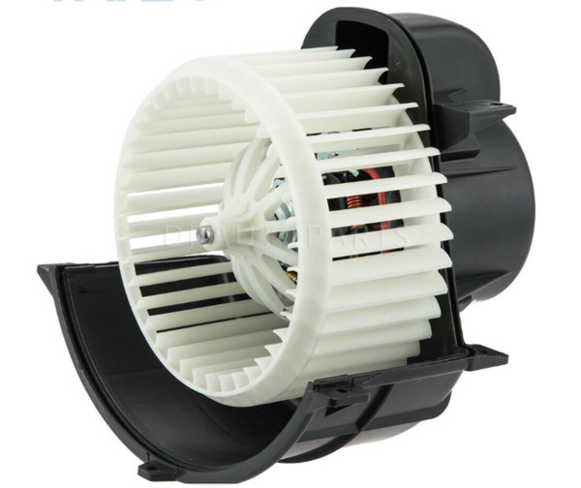
Blower Motor

Slide 4
Compressor

Slide 5
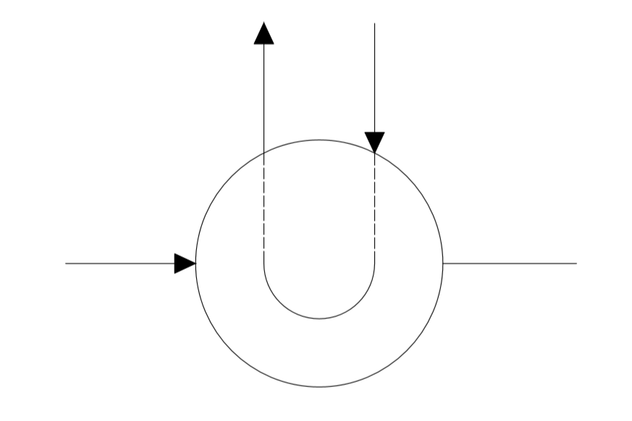
Condenser

Slide 6
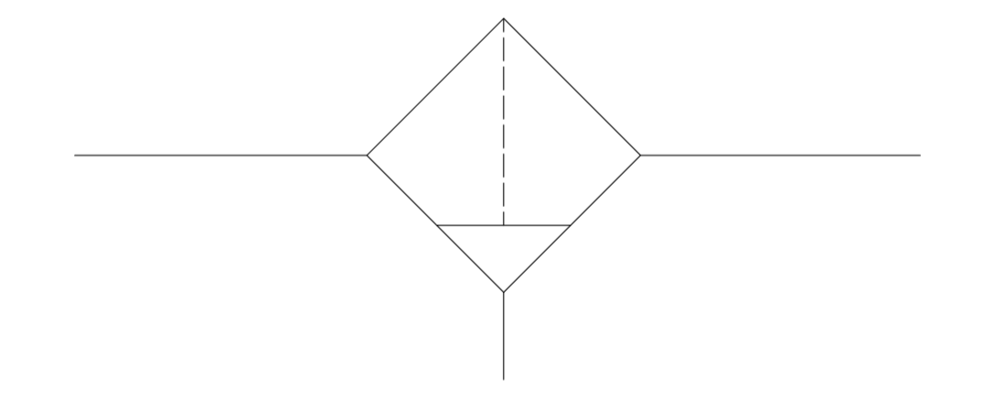
Receiver-Dryer

Slide 7
Expansion Valve

Slide 8
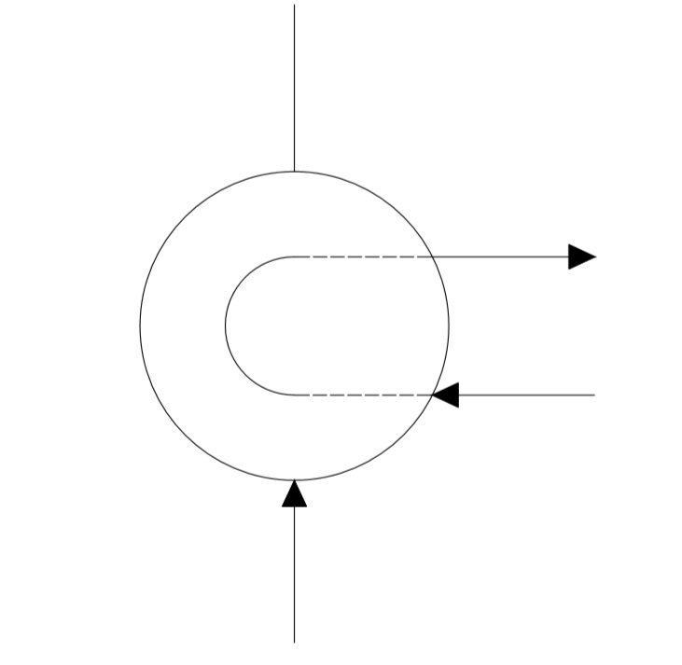
Evaporator

Slide 9
Automobile Air Conditioning
Circuit with 3D Components

Slide 10
Quiz
Number of Blower Fans Needed in a typical Air-Conditioning System?
a) 02
b) 04
c) 03
d) 01

